Slide 1

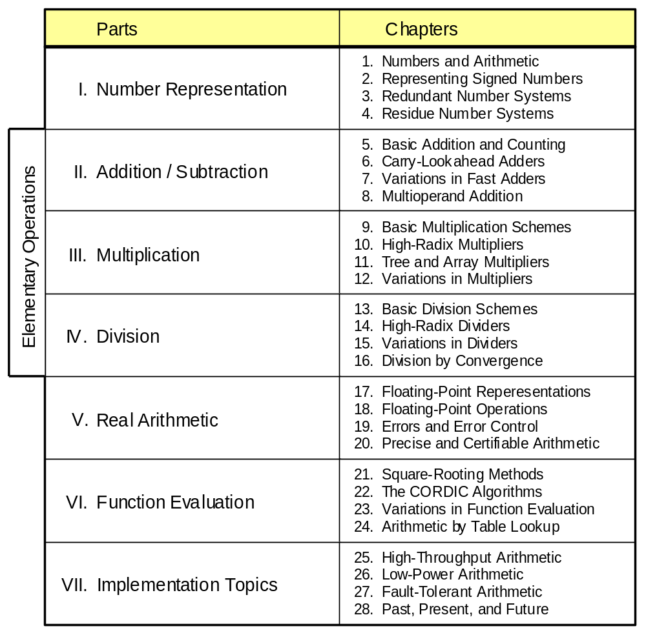
Part V
Real Arithmetic

Slide 2
About This Presentation
This presentation is intended to support the use of the textbook Computer Arithmetic: Algorithms and Hardware Designs (Oxford University Press, 2000, ISBN 0-19-512583-5). It is updated regularly by the author as part of his teaching of the graduate course ECE 252B, Computer Arithmetic, at the University of California, Santa Barbara. Instructors can use these slides freely in classroom teaching and for other educational purposes. Unauthorized uses are strictly prohibited. © Behrooz Parhami
Edition | Released | Revised | Revised | Revised | Revised
First | Jan. 2000 | Sep. 2001 | Sep. 2003 | Oct. 2005 | May 2007

Slide 3
V Real Arithmetic
Review floating-point numbers, arithmetic, and errors:
  How to combine wide range with high precision
  Format and arithmetic ops; the ANSI/IEEE standard
  Causes and consequence of computation errors
  When can we trust computation results?
Topics in This Part
Chapter 17 Floating-Point Representations
Chapter 18 Floating-Point Operations
Chapter 19 Errors and Error Control
Chapter 20 Precise and Certifiable Arithmetic

Slide 4
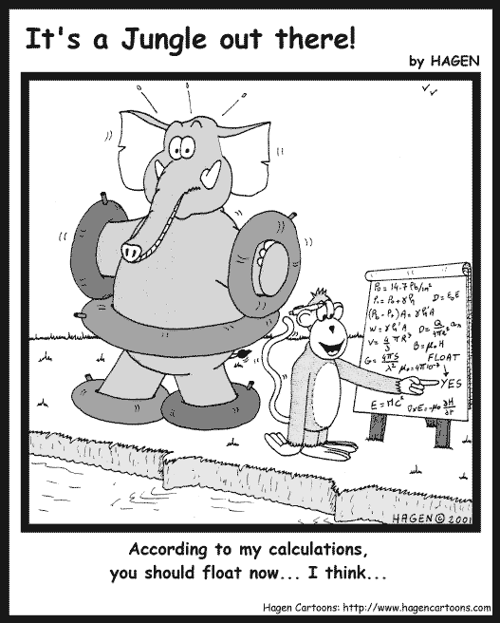

“According to my calculation,
you should float now ... I think ...”
“It’s an inexact science.”

Slide 5
17 Floating-Point Representations
Chapter Goals
Study a representation method offering both
wide range (e.g., astronomical distances)
and high precision (e.g., atomic distances)
Chapter Highlights
Floating-point formats and related tradeoffs
The need for a floating-point standard
Finiteness of precision and range
Fixed-point and logarithmic representations
as special cases at the two extremes

Slide 6
Floating-Point Representations: Topics
Topics in This Chapter
17.1. Floating-Point Numbers
17.2. The ANSI / IEEE Floating-Point Standard
17.3. Basic Floating-Point Algorithms
17.4. Conversions and Exceptions
17.5. Rounding Schemes
17.6. Logarithmic Number Systems

Slide 7
17.1 Floating-Point Numbers
No finite number system can represent all real numbers
Various systems can be used for a subset of real numbers
Fixed-point ± w . f
Rational ± p / q
Floating-point ± s ×b^{e}
Logarithmic ± log_{b}x
Low precision and/or range
Difficult arithmetic
Most common scheme
Limiting case of floating-point
Fixed-point numbers
x = (0000 0000 . 0000 1001)_{two} Small number
y = (1001 0000 . 0000 0000)_{two} Large number
Floating-point numbers
x = ± s × b^{e} or ± significand × base^{exponent}
Note that a floating-point number comes with two signs:
Number sign, usually represented by a separate bit
Exponent sign, usually embedded in the biased exponent

Slide 8
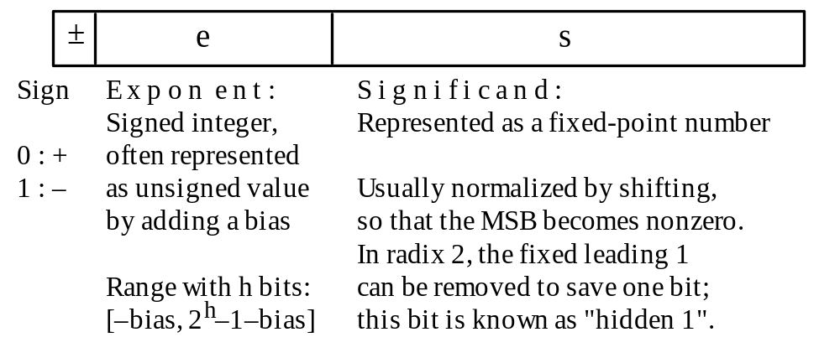
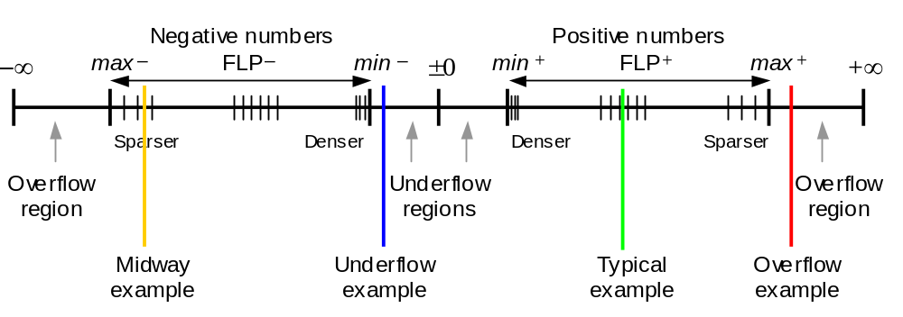
Floating-Point Number Format and Distribution
Fig. 17.1 Typical floating-point number format.
Fig. 17.2 Subranges and special values in floating-point number representations.

Slide 9
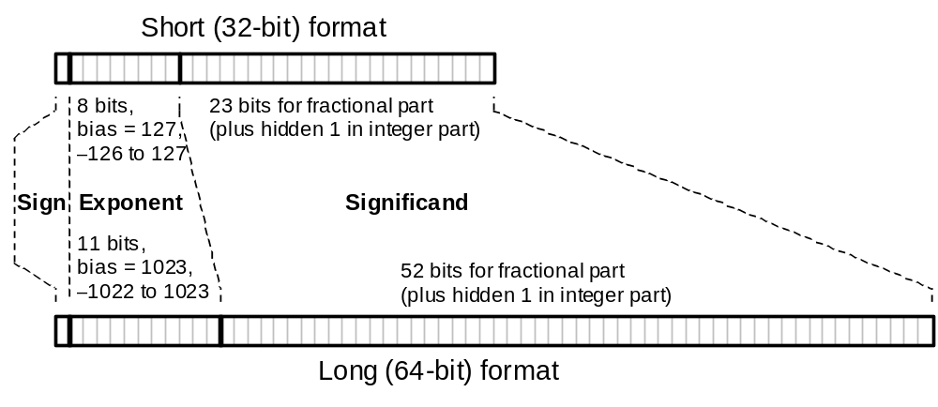
17.2 The ANSI / IEEE Floating-Point Standard
IEEE 754 Standard
(now being revised to yield IEEE 754R)
Fig. 17.3 The ANSI/IEEE standard floating-point number representation formats.

Slide 10
Overview of IEEE 754 Standard Formats
Table 17.1 Some features of the ANSI/IEEE standard floating-point number representation formats.
––––––––––––––––––––––––––––––––––––––––––––––––––––––––
Feature Single / Short Double / Long
––––––––––––––––––––––––––––––––––––––––––––––––––––––––
Word width (bits) 32 64
Significand bits 23 + 1 hidden 52 + 1 hidden
Significand range [1, 2 – 2^{–23}] [1, 2 – 2^{–52}]
Exponent bits 8 11
Exponent bias 127 1023
Zero (±0) e + bias = 0, f = 0 e + bias = 0, f = 0
Denormal e + bias = 0, f ≠ 0 e + bias = 0, f ≠ 0
represents ± 0.f × 2^{–126} represents ±0.f ×2^{–1022}
Infinity (±∞) e + bias = 255, f = 0 e + bias = 2047, f = 0
Not-a-number (NaN) e + bias = 255, f ≠ 0 e + bias = 2047, f ≠ 0
Ordinary number e + bias ∈ [1, 254] e + bias ∈ [1, 2046]
e ∈ [–126, 127] e ∈ [–1022, 1023]
represents 1.f × 2e represents 1.f × 2e
min 2^{–126} ≅ 1.2 × 10^{–38} 2^{–1022} ≅ 2.2 × 10^{–308}
max ≅ 2¹²⁸ ≅ 3.4 × 10³⁸ ≅ 2¹⁰²⁴ ≅ 1.8 × 10³⁰⁸
––––––––––––––––––––––––––––––––––––––––––––––––––––––––

Slide 11
Exponent Encoding
Exponent encoding in 8 bits for the single/short (32-bit) ANSI/IEEE format
Decimal code
0
1
126
127
128
254
255
Hex code
00
01
7E
7F
80
FE
FF
Exponent value
–126
–1
0
+1
+127
1.f × 2e
f = 0: Representation of ±0
f ≠ 0: Representation of denormals,
0.f × 2^{–126}
f = 0: Representation of ±∞
f ≠ 0: Representation of NaNs
Exponent encoding in
11 bits for the double/long (64-bit) format is similar

Slide 12
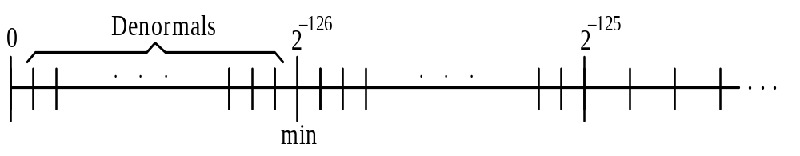
Special Operands and Denormals
Operations on special operands:
Ordinary number ÷ (+∞) = ±0
(+∞) × Ordinary number = ±∞
NaN + Ordinary number = NaN
Biased value
0 1 2 . . . 253 254 255
−126 −125 . . . 126 127
Ordinary FLP numbers
±0, Denormal
(± 0.f × 2^{–126})
±∞, NaN
Fig. 17.4 Denormals in the IEEE single-precision format.

Slide 13
Extended Formats
Single extended
≥ 11 bits
≥ 32 bits
Bias is unspecified, but exponent range must include:
Single extended
[−1022, 1023]
Double extended
[−16 382, 16 383]
≥ 15 bits
≥ 64 bits
Double extended

Slide 14
Requirements for Arithmetic
Results of the 4 basic arithmetic operations (+, −, ×, ÷) as well as square-rooting must match those obtained
if all intermediate computations were infinitely precise
That is, a floating-point arithmetic operation should introduce no more imprecision than the error attributable to the final rounding of a result that has no exact representation (this is the best possible)
Example:
(1 + 2⁻¹) × (1 + 2⁻²³ )
Exact result 1 + 2⁻¹ + 2⁻²³ + 2⁻²⁴
Rounded result 1 + 2⁻¹ + 2⁻²² Error = ½ ulp

Slide 15
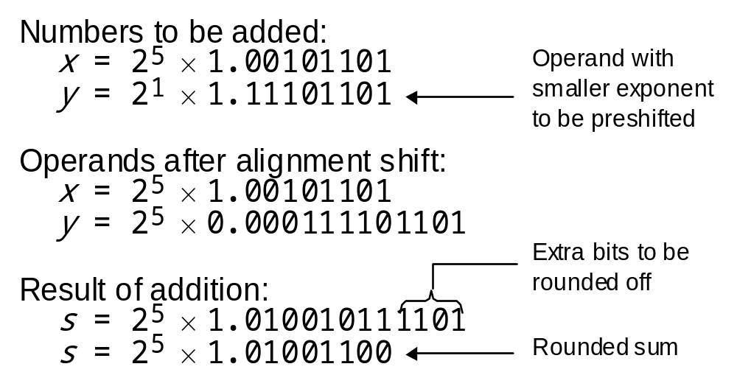
17.3 Basic Floating-Point Algorithms
Addition
Assume e1 ≥ e2; alignment shift (preshift) is needed if e1 > e2
(± s1 × b ^{e1}) + (± s2 × b ^{e2}) = (± s1 × b ^{e1}) + (± s2 / b ^{e1–e2}) × b ^{e1}
= (± s1 ± s2 / b ^{e1–e2}) × b ^{e1} = ± s × b ^{e}
Example:
Rounding, overflow, and underflow issues discussed later

Slide 16
Floating-Point Multiplication and Division
Multiplication
(± s1 × b ^{e1}) × (± s2 × b ^{e2}) = (± s1 × s2 ) × b ^{e1+e2}
Because s1 × s2 ∈ [1, 4), postshifting may be needed for normalization
Overflow or underflow can occur during multiplication or normalization
Division
(± s1 × b ^{e1}) / (± s2 × b ^{e2}) = (± s1 / s2 ) × b ^{e1−e2}
Because s1 / s2 ∈ (0.5, 2), postshifting may be needed for normalization
Overflow or underflow can occur during division or normalization

Slide 17
Floating-Point Square-Rooting
For e even: s × b ^{e} = s × b ^{e/2}
For e odd: bs × b ^{e−1} = bs × b ^{(e–1) / 2}
After the adjustment of s to bs and e to e – 1, if needed, we have:
s* × b ^{e*} = s* × b ^{e*/2}
Even
In [1, 4)
for IEEE 754
In [1, 2)
for IEEE 754
Overflow or underflow is impossible; no postnormalization needed

Slide 18
17.4 Conversions and Exceptions
Conversions from fixed- to floating-point
Conversions between floating-point formats
Conversion from high to lower precision: Rounding
ANSI/IEEE standard includes four rounding modes:
Round to nearest even [default rounding mode]
Round toward zero (inward)
Round toward +∞ (upward)
Round toward –∞ (downward)

Slide 19
Exceptions in Floating-Point Arithmetic
Divide by zero
Overflow
Underflow
Inexact result: Rounded value not the same as original
Invalid operation: examples include
Addition (+∞) + (–∞)
Multiplication 0 × ∞
Division 0 / 0 or ∞ / ∞
Square-rooting operand < 0

Slide 20
17.5 Rounding Schemes
Whole part
Fractional part
x_{k–1}x_{k–2} . . . x₁x₀ . x_{–1}x_{–2} . . . x_{–l} y_{k–1}y_{k–2} . . . y₁y₀
Round
ulp
The simplest possible rounding scheme: chopping or truncation
x_{k–1}x_{k–2} . . . x₁x₀ . x_{–1}x_{–2} . . . x_{–l} x_{k–1}x_{k–2} . . . x₁x₀
Chop
ulp

Slide 21
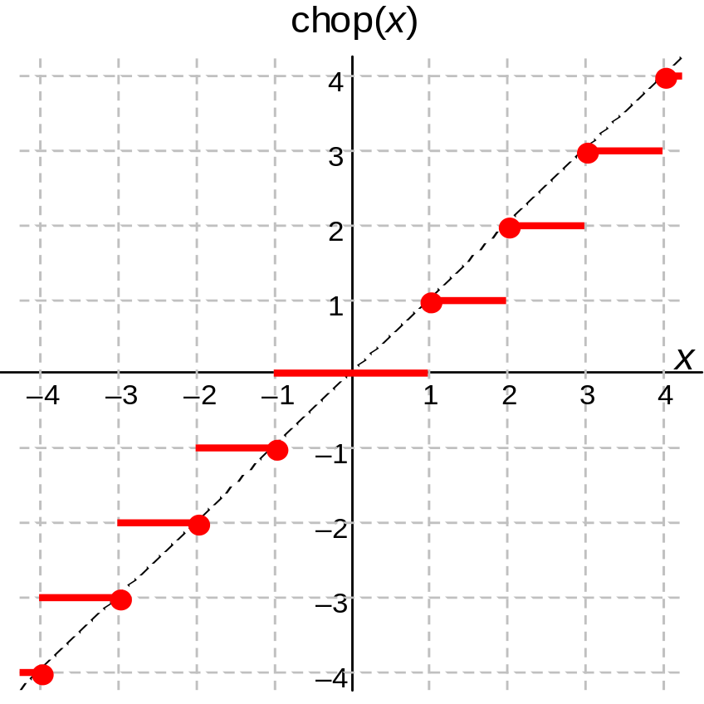
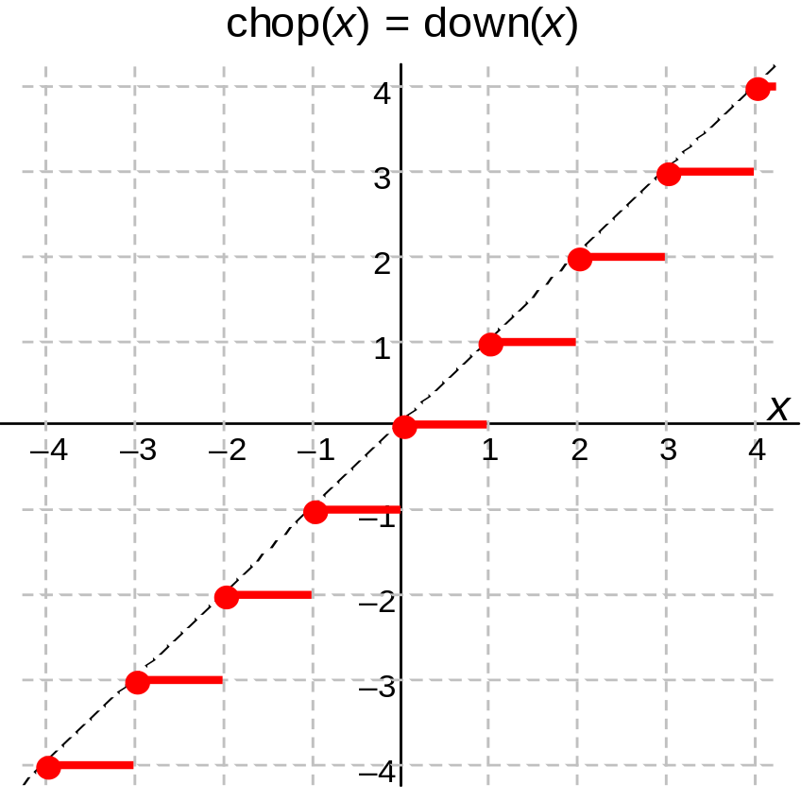
Truncation or Chopping
Fig. 17.5 Truncation or chopping of a signed-magnitude number (same as round toward 0).
Fig. 17.6 Truncation or chopping of a 2’s-complement number (same as downward-directed rounding).

Slide 22
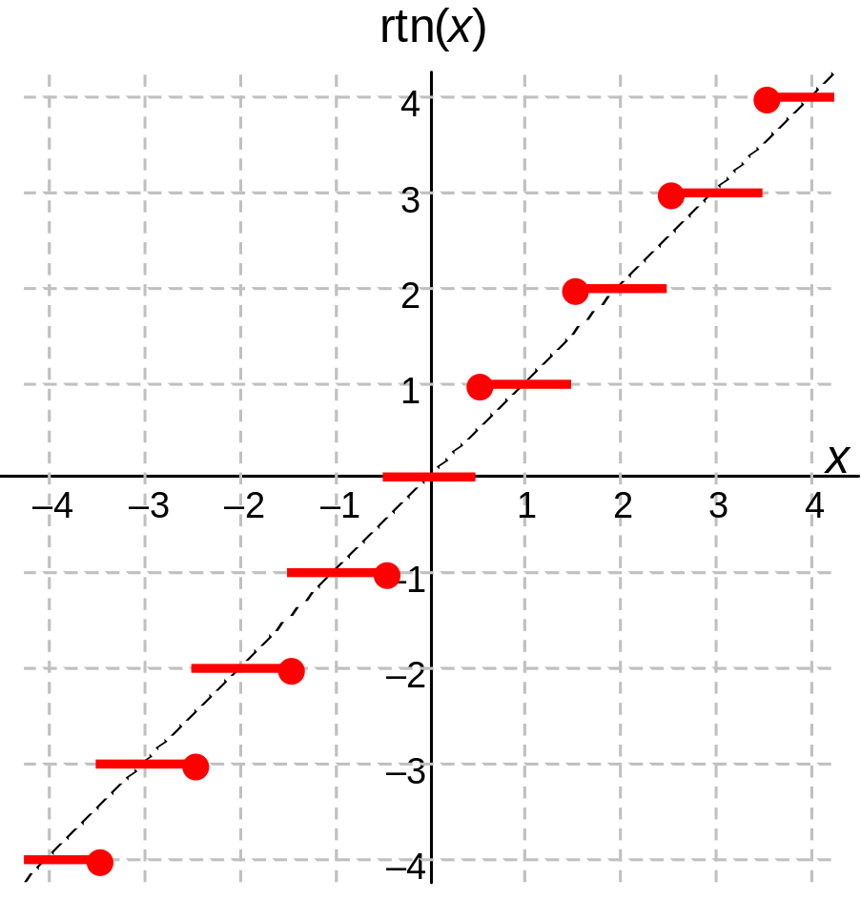
Round to Nearest Number
Rounding has a slight upward bias. Consider rounding
(x_{k–1}x_{k–2} ... x₁x₀ . x_{–1}x_{–2})_{two}
to an integer (y_{k–1}y_{k–2} ... y₁y₀ . )_{two}
The four possible cases, and their representation errors are:
x_{–1}x_{–2} Round Error
00 down 0
01 down –0.25
10 up 0.5
11 up 0.25
With equal prob., mean = 0.125
For certain calculations, the probability of getting a midpoint value can be much higher than 2^{–l}
Fig. 17.7 Rounding of a signed-magnitude value to the nearest number.

Slide 23
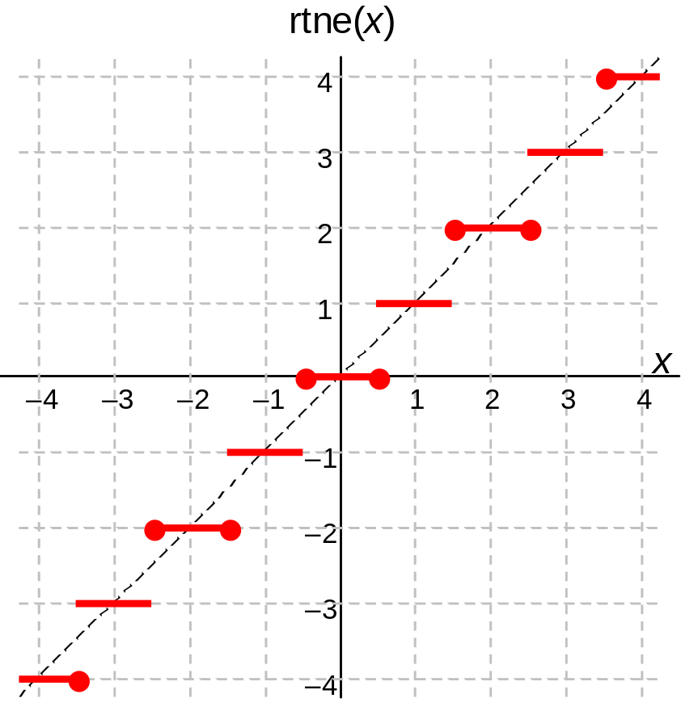
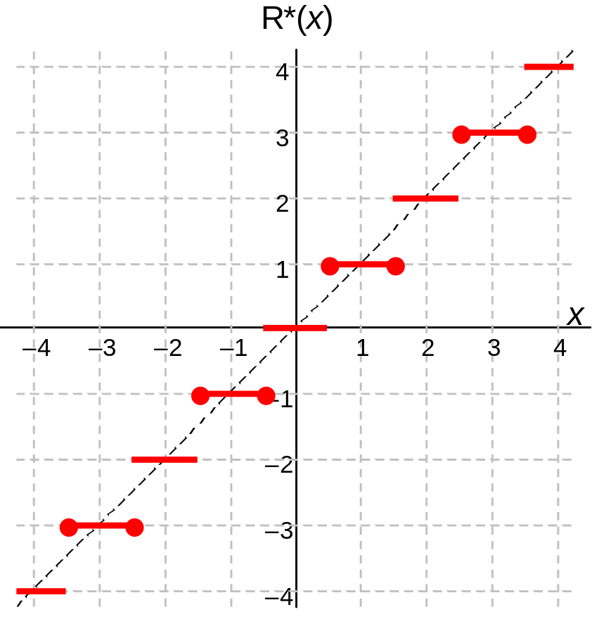
Round to Nearest Even Number
Fig. 17.8 Rounding to the nearest even number.
Fig. 17.9 R* rounding or rounding to the nearest odd number.

Slide 24
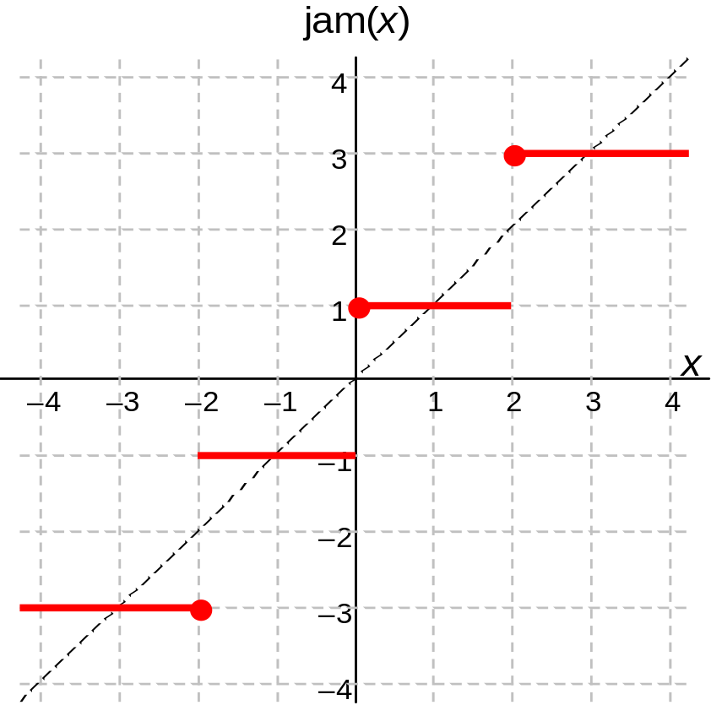
A Simple Symmetric Rounding Scheme
Chop and force the LSB of the result to 1
Simplicity of chopping, with the near-symmetry or ordinary rounding
Max error is comparable to chopping (double that of rounding)
Fig. 17.10 Jamming or
von Neumann rounding.

Slide 25
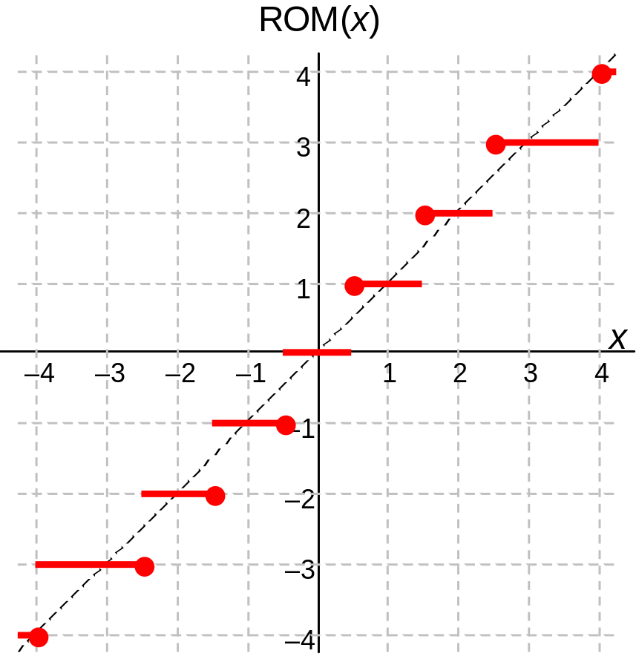
ROM Rounding
Fig. 17.11 ROM rounding with an 8 × 2 table.
Example: Rounding with a
32 × 4 table
Rounding result is the same as that of the round to nearest scheme in 31 of the 32 possible cases, but a larger error is introduced when
x₃ = x₂ = x₁ = x₀ = x_{–1} = 1
x_{k–1} . . . x₄x₃x₂x₁x₀ . x_{–1}x_{–2} . . . x_{–l} x_{k–1} . . . x₄y₃y₂y₁y₀
ROM
ROM address
ROM data

Slide 26
Directed Rounding: Motivation
We may need result errors to be in a known direction
Example: in computing upper bounds,
larger results are acceptable,
but results that are smaller than correct values
could invalidate the upper bound
This leads to the definition of directed rounding modes
upward-directed rounding (round toward +∞) and
downward-directed rounding (round toward –∞)
(required features of IEEE floating-point standard)

Slide 27
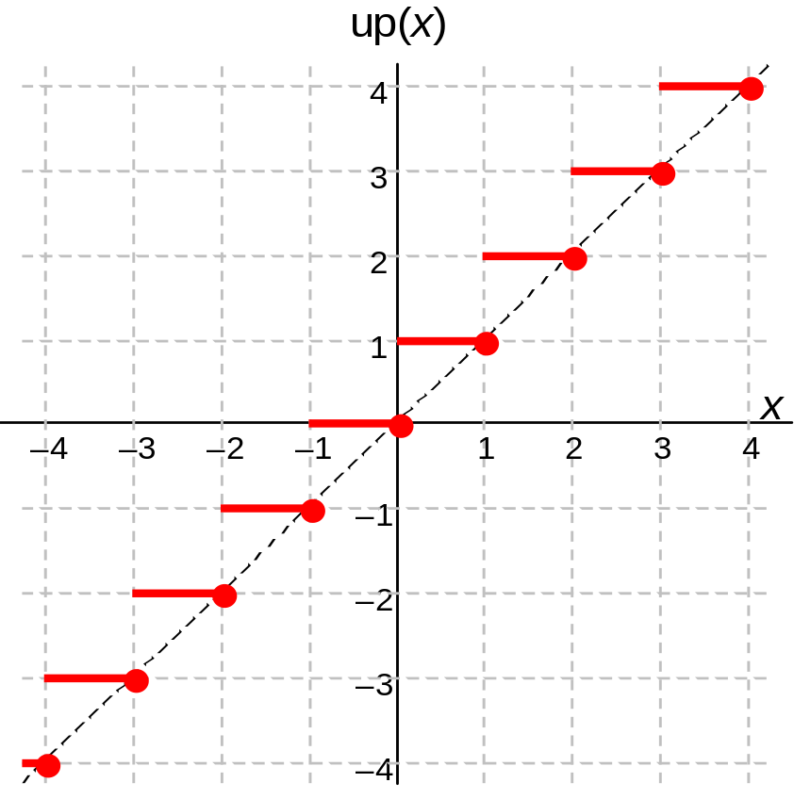
Directed Rounding: Visualization
Fig. 17.12 Upward-directed rounding or rounding toward +∞.
Fig. 17.6 Truncation or chopping of a 2’s-complement number (same as downward-directed rounding).

Slide 28
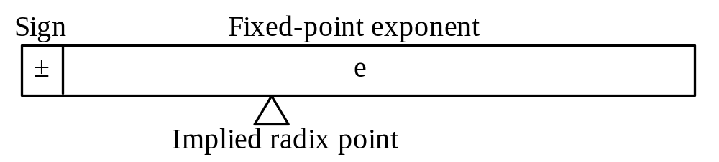
17.6 Logarithmic Number Systems
Sign-and-logarithm number system: Limiting case of FLP representation
x = ± b^{e} × 1 e = log_{b} |x|
We usually call b the logarithm base, not exponent base
Using an integer-valued e wouldn’t be very useful, so we consider e to be a fixed-point number
Fig. 17.13 Logarithmic number representation with sign and fixed-point exponent.

Slide 29
Properties of Logarithmic Representation
The logarithm is often represented as a 2’s-complement number
(Sx, Lx) = (sign(x), log₂ |x|)
Simple multiplication and division; harder add and subtract
L(xy) = Lx + Ly L(x/y) = Lx – Ly
Example: 12-bit, base-2, logarithmic number system
1 1 0 1 1 0 0 0 1 0 1 1
^{Δ}
Sign Radix point
The bit string above represents –2^{–9.828125} ≅ –(0.0011)_{ten}
Number range ≅ (–2¹⁶, 2¹⁶); min = 2^{–16}

Slide 30
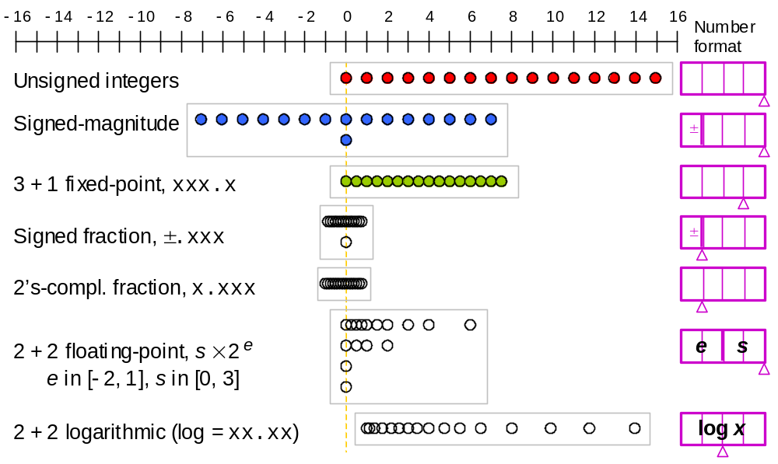
Advantages of Logarithmic Representation
Fig. 1.2 Some of the possible ways of assigning 16 distinct codes to represent numbers.

Slide 31
18 Floating-Point Operations
Chapter Goals
See how adders, multipliers, and dividers
are designed for floating-point operands
(square-rooting postponed to Chapter 21)
Chapter Highlights
Floating-point operation = preprocessing +
exponent and significand arithmetic +
postprocessing (+ exception handling)
Adders need preshift, postshift, rounding
Multipliers and dividers are easy to design

Slide 32
Floating-Point Operations: Topics
Topics in This Chapter
18.1. Floating-Point Adders / Subtractors
18.2. Pre- and Postshifting
18.3. Rounding and Exceptions
18.4. Floating-Point Multipliers
18.5. Floating-Point Dividers
18.6. Logarithmic Arithmetic Unit

Slide 33
18.1 Floating-Point Adders/Subtractors
Floating-Point Addition Algorithm
Assume e1 ≥ e2; alignment shift (preshift) is needed if e1 > e2
(± s1 × b ^{e1}) + (± s2 × b ^{e2}) = (± s1 × b ^{e1}) + (± s2 / b ^{e1–e2}) × b ^{e1}
= (± s1 ± s2 / b ^{e1–e2}) × b ^{e1} = ± s × b ^{e}
Example:
Like signs:
Possible 1-position normalizing right shift
Different signs:
Possible left shift by many positions
Overflow/underflow during addition or normalization
-

Slide 34
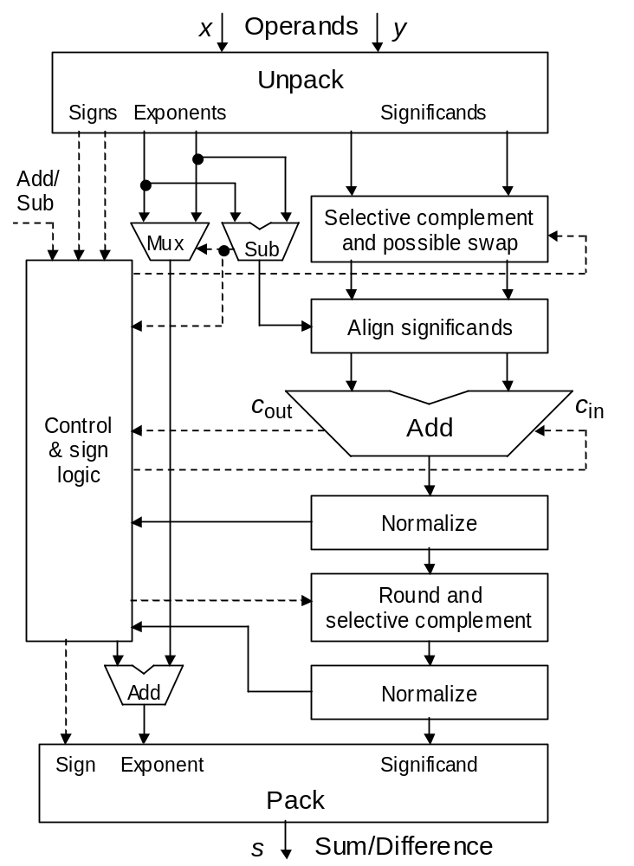
FLP Addition Hardware
Isolate the sign, exponent, significand
Reinstate the hidden 1
Convert operands to internal format
Identify special operands, exceptions
Fig. 18.1 Block diagram of a floating-point adder/subtractor.
Other key parts of the adder:
Significand aligner (preshifter): Sec. 18.2
Result normalizer (postshifter), including
leading 0s detector/predictor: Sec. 18.2
Rounding unit: Sec. 18.3
Sign logic: Problem 18.2
Converting internal to external representation, if required, must be done at the rounding stage
Combine sign, exponent, significand
Hide (remove) the leading 1
Identify special outcomes, exceptions

Slide 35
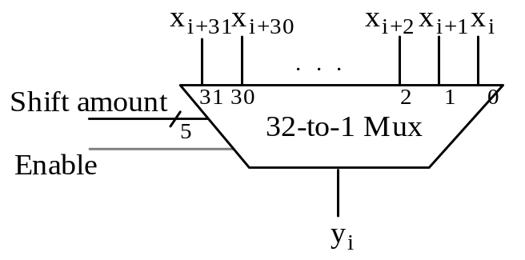
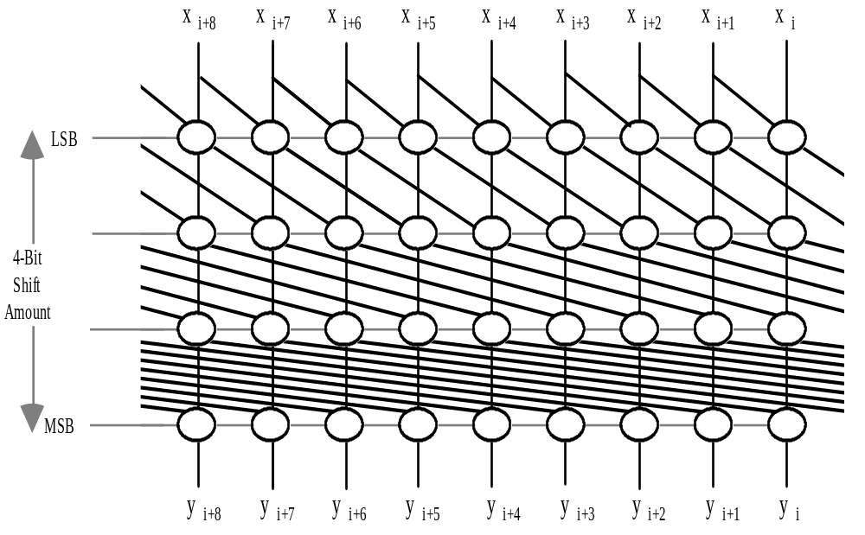
18.2 Pre- and Postshifting
Fig. 18.2 One bit-slice of a single-stage pre-shifter.
Fig. 18.3
Four-stage combinational shifter for preshifting
an operand
by 0 to 15 bits.

Slide 36
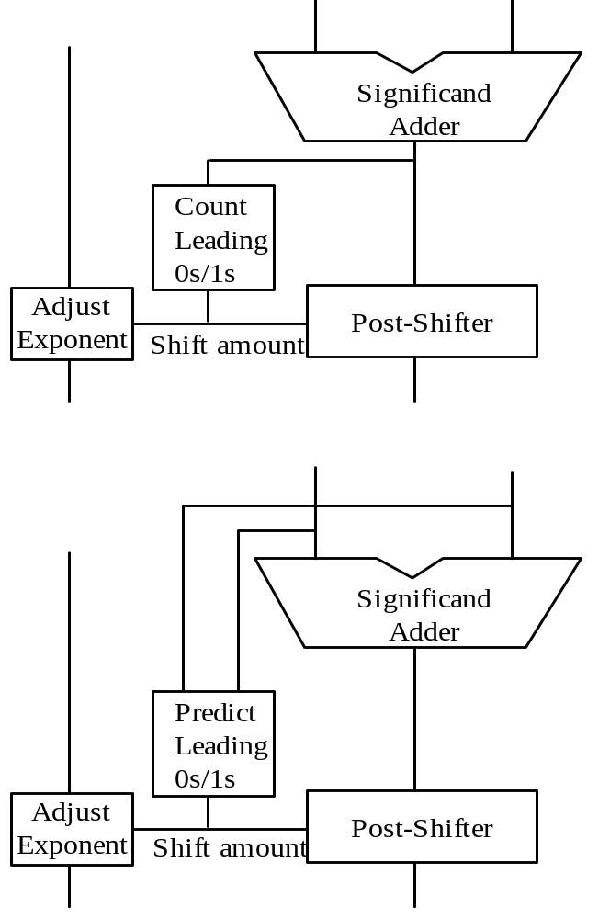
Leading Zeros / Ones Detection or Prediction
Leading zeros prediction, with adder inputs
(0x₀.x_{–1}x_{–2} ...)_{2’s-compl} and (0y₀.y_{–1}y_{–2} ...)_{2’s-compl}
Ways in which leading 0s/1s are generated:
p p . . . p p g a a . . . a a g . . .
p p . . . p p g a a . . . a a p . . .
p p . . . p p a g g . . . g g a . . .
p p . . . p p a g g . . . g g p . . .
Prediction might be done in two stages:
• Coarse estimate, used for coarse shift
• Fine tuning of estimate, used for fine shift
In this way, prediction can be
partially overlapped with shifting
Fig. 18.4 Leading zeros/ones counting versus prediction.

Slide 37
18.3 Rounding and Exceptions
Adder result = (c_{out}z₁z₀ . z_{–1}z_{–2} . . . z_{–l} G R S)_{2’s-compl}
Guard bit
Sticky bit
Round bit
OR of all bits shifted past R
Why only 3 extra bits?
Amount of alignment right-shift
One bit: G holds the bit that is shifted out, no precision is lost
Two bits or more: Shifted significand has a magnitude in [0, 1/2)
Unshifted significand has a magnitude in [1, 2)
Difference of aligned significands has a magnitude in [1/2, 2)
Normalization left-shift will be by at most one bit
If a normalization left-shift actually takes place:
R = 0, round down, discarded part < ulp/2
R = 1, round up, discarded part ≥ ulp/2
The only remaining question is establishing whether the discarded part is exactly ulp/2 (for round to nearest even); S provides this information

Slide 38
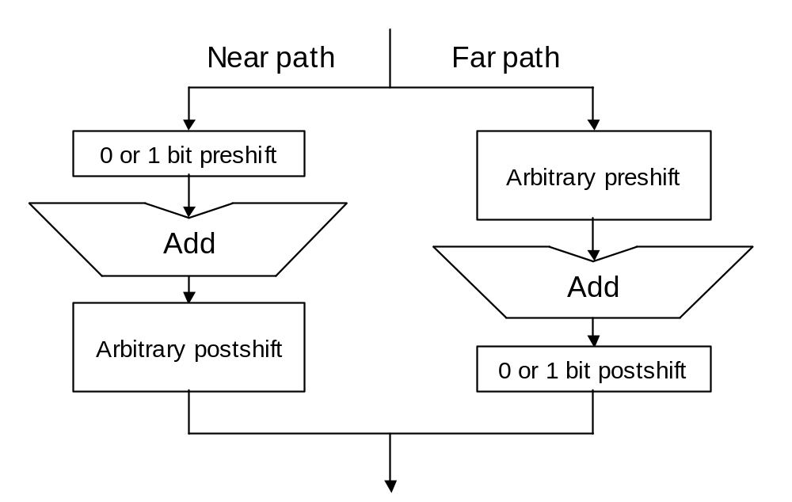
Floating-Point Adder with Dual Data Paths
Amount of alignment right-shift
One bit: Arbitrary left shift may be needed due to cancellation
Two bits or more: Normalization left-shift will be by at most one bit
Control

Slide 39
Implementation of Rounding for Addition
The effect of 1-bit normalization shifts on the rightmost few bits of
the significand adder output is as follows:
Before postshifting (z) . . . z_{–l+1} z_{–l} | G R S
1-bit normalizing right-shift . . . z_{–l+2} z_{–l+1} | z_{–l} G R ∨ S
1-bit normalizing left-shift . . . z_{–l} G | R S 0
After normalization (Z) . . . Z_{–l+1} Z_{–l} | Z_{–l–1} Z_{–l–2} Z_{–l–3}
Note that no rounding is needed in case of multibit left-shift,
because full precision is preserved in this case
Round to nearest even:
Do nothing if Z_{–l–1} = 0 or Z_{–l} = Z_{–l–2} = Z_{–l–3} = 0
Add ulp = 2^{–l} otherwise

Slide 40
Exceptions in Floating-Point Addition
Overflow/underflow detected by exponent adjustment block in Fig. 18.1
Overflow can occur only for
normalizing right-shift
Underflow possible only with
normalizing left shifts
Exceptions involving NaNs and invalid operations handled by unpacking and packing blocks in Fig. 18.1
Zero detection: Special case of
leading 0s detection
Determining when “inexact” exception must be signaled left as an exercise

Slide 41
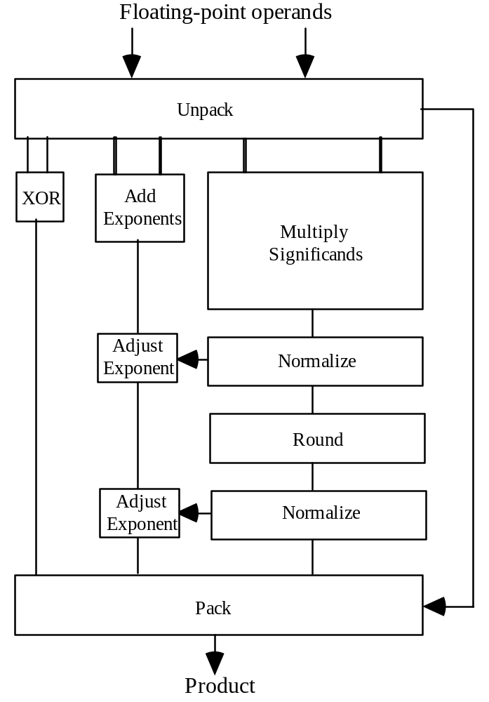
18.4 Floating-Point Multipliers
(± s1 × b ^{e1}) × (± s2 × b ^{e2}) = (± s1 × s2 ) × b ^{e1+e2}
s1 × s2 ∈ [1, 4): may need postshifting
Overflow or underflow can occur during
multiplication or normalization
Speed considerations
Many multipliers produce the lower half of the product (rounding info) early
Need for normalizing right-shift is known at or near the end
Hence, rounding can be integrated in
the generation of the upper half,
by producing two versions of these bits
Fig. 18.5 Block diagram of a floating-point multiplier.

Slide 42
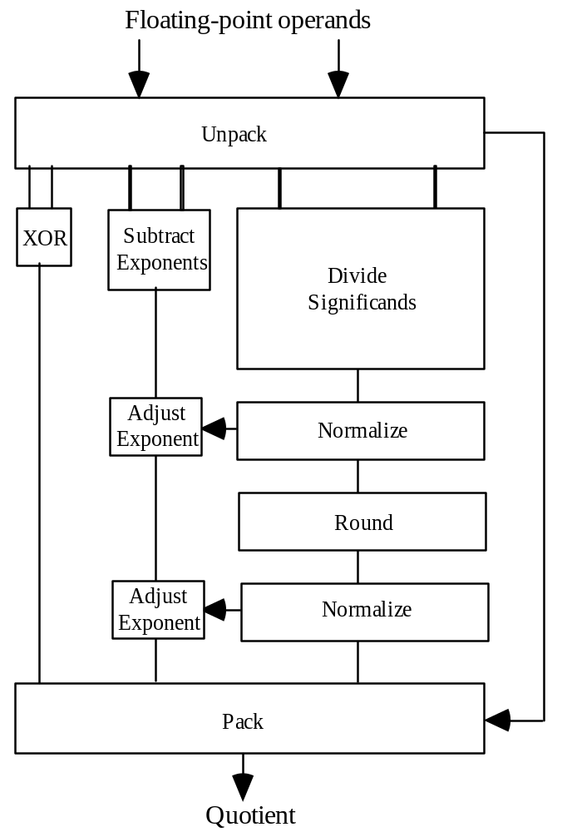
18.5 Floating-Point Dividers
(± s1 × b ^{e1}) / (± s2 × b ^{e2}) = (± s1 / s2 ) × b ^{e1−e2}
s1 / s2 ∈ (0.5, 2): may need postshifting
Overflow or underflow can occur during
division or normalization
Note: Square-rooting never leads to overflow or underflow
Rounding considerations
Quotient must be produced with two extra bits (G and R), in case of the need for a normalizing left shift
The remainder acts as the sticky bit
Fig. 18.6 Block diagram of a floating-point divider.

Slide 43
18.6 Logarithmic Arithmetic Unit
Multiply/divide algorithm in LNS
log(x y) = log x + log y
log(x / y) = log x – log y
Add/subtract algorithm in LNS
(Sx, Lx) ± (Sy, Ly) = (Sz, Lz)
Assume x > y > 0 (other cases are similar)
Lz = log z = log(x ± y) = log(x(1 ± y/x)) = log x + log(1 ± y/x)
Given Δ = – (log x – log y), the term log(1 ± y/x) = log(1 ± log^{–1}Δ)
is obtained from a table (two tables φ⁺ and φ– needed)
log(x + y) = log x + φ⁺(Δ)
log(x – y) = log x + φ–(Δ)

Slide 44
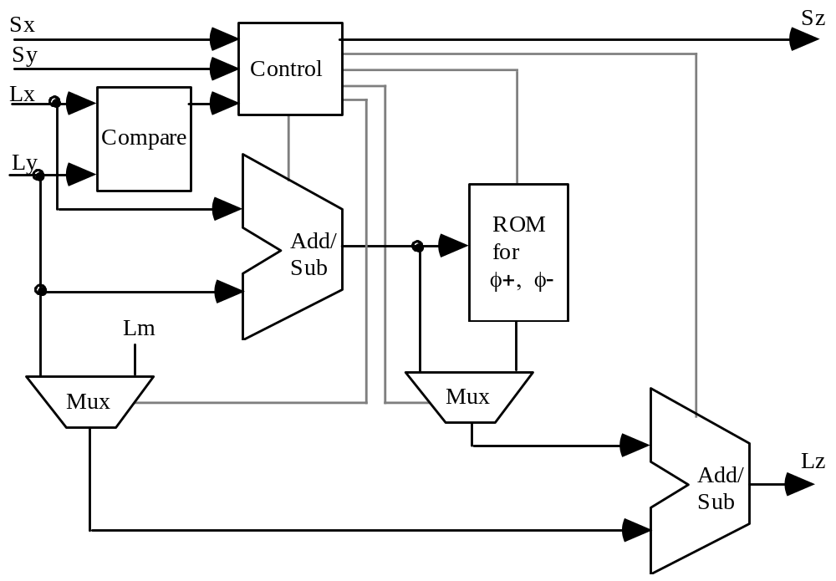
Four-Function Logarithmic Arithmetic Unit
op
log(x y) = log x + log y
log(x / y) = log x – log y
Log of the scale factor m which allows values in [0, 1] to be represented as unsigned log’s
log(x + y) = log x + φ⁺(Δ)
log(x – y) = log x + φ–(Δ)
Fig. 18.7 Arithmetic unit for a logarithmic number system.

Slide 45
19 Errors and Error Control
Chapter Goals
Learn about sources of computation errors,
consequences of inexact arithmetic,
and methods for avoiding or limiting errors
Chapter Highlights
Representation and computation errors
Absolute versus relative error
Worst-case versus average error
Why 3 × (1/3) does not necessarily yield 1
Error analysis and bounding

Slide 46
Errors and Error Control: Topics
Topics in This Chapter
19.1. Sources of Computational Errors
19.2. Invalidated Laws of Algebra
19.3. Worst-Case Error Accumulation
19.4. Error Distribution and Expected Errors
19.5. Forward Error Analysis
19.6. Backward Error Analysis

Slide 47
19.1 Sources of Computational Errors
FLP approximates exact computation with real numbers
Two sources of errors to understand and counteract:
Representation errors
e.g., no machine representation for 1/3, √2, or π
Arithmetic errors
e.g., (1 + 2^{–12})² = 1 + 2^{–11} + 2^{–24}
not representable in IEEE 754 short format
We saw early in the course that errors due to finite precision can lead to disasters in life-critical applications

Slide 48
Example Showing Representation and Arithmetic Errors
Example 19.1: Compute 1/99 – 1/100, using a decimal floating-point format with 4-digit significand in [1, 10) and single-digit signed exponent
Precise result = 1/9900 ≅ 1.010 × 10^{–4} (error ≅ 10^{–8} or 0.01%)
Chopped to 3 decimals
x = 1/99 ≅ 1.010 × 10^{–2} Error ≅ 10^{–6} or 0.01%
y = 1/100 = 1.000 × 10^{–2} Error = 0
z = x –_{fp} y = 1.010 × 10^{–2} – 1.000 × 10^{–2} = 1.000 × 10^{–4}
Error ≅ 10^{–6} or 1%

Slide 49
Notation for a General Floating-Point System
Number representation in FLP(r, p, A)
Radix r (assume to be the same as the exponent base b)
Precision p in terms of radix-r digits
Approximation scheme A ∈ {chop, round, rtne, chop(g), . . .}
Let x = r ^{e}s be an unsigned real number, normalized such that 1/r ≤ s < 1,
and assume x_{fp} is the representation of x in FLP(r, p, A)
x_{fp} = r ^{e} s_{fp} = (1 + η)x η is the relative representation error
A = chop –ulp < s_{fp} – s ≤ 0 –r × ulp < η ≤ 0
A = round –ulp/2 < s_{fp} – s ≤ ulp/2 | η | ≤ r × ulp/2
Arithmetic in FLP(r, p, A)
Obtain an infinite-precision result, then chop, round, . . .
Real machines approximate this process by keeping g > 0 guard digits, thus doing arithmetic in FLP(r, p, chop(g))

Slide 50
Error Analysis for Multiplication and Division
Errors in floating-point multiplication
Consider the positive operands x_{fp} and y_{fp}
x_{fp} ×_{fp} y_{fp} = (1 + η) x_{fp} y_{fp}
= (1 + η)(1 + σ)(1 + τ) xy
= (1 + η + σ + τ + ησ + ητ + στ + ηστ) xy
≅ (1 + η + σ + τ) xy
Errors in floating-point division
Again, consider positive operands x_{fp} and y_{fp}
x_{fp} /_{fp} y_{fp} = (1 + η) x_{fp} / y_{fp}
= (1 + η)(1 + σ)x / [(1 + τ)y]
= (1 + η)(1 + σ)(1 – τ)(1 + τ²)(1 + τ⁴)( . . . ) x/y
≅ (1 + η + σ – τ) x / y

Slide 51
Error Analysis for Addition and Subtraction
Errors in floating-point addition
Consider the positive operands x_{fp} and y_{fp}
x_{fp} +_{fp} y_{fp} = (1 + η)(x_{fp} + y_{fp})
= (1 + η)(x + σx + y + τy)
_{σx + τy}
= (1 + η)(1 + )(x + y)
^{x + y}
Magnitude of this ratio
is upper-bounded by max(| σ | |, | τ |), so the overall error is no more than | η | + max(| σ | |, | τ |)
Errors in floating-point subtraction
Again, consider positive operands x_{fp} and y_{fp}
x_{fp} −_{fp} y_{fp} = (1 + η)(x_{fp} − y_{fp})
= (1 + η)(x + σx − y − τy)
_{σx − τy}
= (1 + η)(1 + )(x − y)
^{x − y}
Magnitude of this ratio can be very large if x and y are both large but x – y is relatively small (recall that τ can be negative)
This term also
unbounded
for subtraction

Slide 52
Cancellation Error in Subtraction
_{σx − τy}
x_{fp} −_{fp} y_{fp} = (1 + η)(1 + )(x − y) Subtraction result
^{x − y}
Example 19.2: Decimal FLP system, r = 10, p = 6, no guard digit
x = 0.100 000 000 × 10³ y = –0.999 999 456 × 10²
x_{fp} = .100 000 × 10³ y_{fp} = – .999 999 × 10²
x + y = 0.544 × 10^{–4} and x_{fp} + y_{fp} = 0.1 × 10^{–3}
x_{fp} +_{fp} y_{fp} = 0.100 000 × 10³ −_{fp} 0.099 999 × 10³ = 0.100 000 × 10⁻²
Relative error = (10^{–3} – 0.544 × 10^{–4}) / (0.544 × 10^{–4}) ≅ 17.38 = 1738%
Now, ignore representation errors, so as to focus on the effect of η
(measure relative error with respect to x_{fp} + y_{fp}, not x + y)
Relative error = (10^{–3} – 10^{–4}) / 10^{–4} = 9 = 900%

Slide 53
Bringing Cancellation Errors in Check
_{σx − τy}
x_{fp} −_{fp} y_{fp} = (1 + η)(1 + )(x − y) Subtraction result
^{x − y}
Example 19.2 (cont.): Decimal FLP system, r = 10, p = 6, 1 guard digit
x = 0.100 000 000 × 10³ y = –0.999 999 456 × 10²
x_{fp} = .100 000 × 10³ y_{fp} = – .999 999 × 10²
x + y = 0.544 × 10^{–4} and x_{fp} + y_{fp} = 0.1 × 10^{–3}
x_{fp} +_{fp} y_{fp} = 0.100 000 × 10³ −_{fp} 0.099 999 9 × 10³ = 0.100 000 × 10⁻³
Relative error = (10^{–4} – 0.544 × 10^{–4}) / (0.544 × 10^{–4}) ≅ 0.838 = 83.8%
Now, ignore representation errors, so as to focus on the effect of η
(measure relative error with respect to x_{fp} + y_{fp}, not x + y)
Relative error = 0 Significantly better than 900%!

Slide 54
How Many Guard Digits Do We Need?
_{σx − τy}
x_{fp} −_{fp} y_{fp} = (1 + η)(1 + )(x − y) Subtraction result
^{x − y}
Theorem 19.1: In the floating-point system FLP(r, p, chop(g)) with g ≥ 1 and –x < y < 0 < x, we have:
x_{fp} +_{fp} y_{fp} = (1 + η)(x_{fp} + y_{fp}) with –r ^{–p+1} < η < r^{–p–g+2}
Corollary: In FLP(r, p, chop(1))
x_{fp} +_{fp} y_{fp} = (1 + η)(x_{fp} + y_{fp}) with | η | < –r ^{–p+1}
So, a single guard digit is sufficient to make the relative arithmetic error in floating-point addition or subtraction comparable to relative representation error with truncation

Slide 55
19.2 Invalidated Laws of Algebra
Many laws of algebra do not hold for floating-point arithmetic (some don’t even hold approximately)
This can be a source of confusion and incompatibility
Associative law of addition: a + (b + c) = (a + b) + c
a = 0.123 41 × 10⁵ b = – 0.123 40 × 10⁵ c = 0.143 21 × 10¹
a +_{fp} (b +_{fp} c)
= 0.123 41 × 10⁵ +_{fp} (– 0.123 40 × 10⁵ +_{fp} 0.143 21 × 10¹)
= 0.123 41 × 10⁵ –_{fp} 0.123 39 × 10⁵
= 0.200 00 × 10¹
(a +_{fp} b) +_{fp} c
= (0.123 41 × 10⁵ –_{fp} 0.123 40 × 10⁵) +_{fp} 0.143 21 × 10¹
= 0.100 00 × 10¹ +_{fp} 0.143 21 × 10¹
= 0.243 21 × 10¹
Results differ
by more than 20%!

Slide 56
Do Guard Digits Help with Laws of Algebra?
Invalidated laws of algebra are intrinsic to FLP arithmetic; problems are reduced, but don’t disappear, with guard digits
Let’s redo our example with 2 guard digits
Associative law of addition: a + (b + c) = (a + b) + c
a = 0.123 41 × 10⁵ b = – 0.123 40 × 10⁵ c = 0.143 21 × 10¹
a +_{fp} (b +_{fp} c)
= 0.123 41 × 10⁵ +_{fp} (– 0.123 40 × 10⁵ +_{fp} 0.143 21 × 10¹)
= 0.123 41 × 10⁵ –_{fp} 0.123 385 7 × 10⁵
= 0.243 00 × 10¹
(a +_{fp} b) +_{fp} c
= (0.123 41 × 10⁵ –_{fp} 0.123 40 × 10⁵) +_{fp} 0.143 21 × 10¹
= 0.100 00 × 10¹ +_{fp} 0.143 21 × 10¹
= 0.243 21 × 10¹
Difference of about 0.1% is better, but still too high!

Slide 57
Unnormalized Floating-Point Arithmetic
One way to reduce problems resulting from invalidated laws of algebra is to avoid normalizing computed floating-point results
Let’s redo our example with unnormalized arithmetic
Associative law of addition: a + (b + c) = (a + b) + c
a = 0.123 41 × 10⁵ b = – 0.123 40 × 10⁵ c = 0.143 21 × 10¹
a +_{fp} (b +_{fp} c)
= 0.123 41 × 10⁵ +_{fp} (– 0.123 40 × 10⁵ +_{fp} 0.143 21 × 10¹)
= 0.123 41 × 10⁵ –_{fp} 0.123 39 × 10⁵
= 0.000 02 × 10⁵
(a +_{fp} b) +_{fp} c
= (0.123 41 × 10⁵ –_{fp} 0.123 40 × 10⁵) +_{fp} 0.143 21 × 10¹
= 0.000 01 × 10⁵ +_{fp} 0.143 21 × 10¹
= 0.000 02 × 10⁵
Results are the same and also carry a kind of warning

Slide 58
Other Invalidated Laws of Algebra with FLP Arithmetic
Associative law of multiplication a × (b × c) = (a × b) × c
Cancellation law (for a > 0) a × b = a × c implies b = c
Distributive law a × (b + c) = (a × b) + (a × c)
Multiplication canceling division a × (b / a) = b
Before the ANSI-IEEE floating-point standard became available and widely adopted, these problems were exacerbated by the use of many incompatible formats

Slide 59
Effects of Algorithms on Result Precision
Example 19.3: The formula x = –b ± d, with d = (b ² – c)^{1/2},
yielding the roots of the quadratic equation x ² + 2bx + c = 0,
can be rewritten as x = –c / (b ± d)
When c is small compared with b ², the root –b + d will have a large error due to cancellation; in such a case, use –c / (b + d) for that root
Confirmation that –b + d = –c / (b + d) ⇒ –c = d ² – b ²
Example 19.4: The area of a triangle with sides a, b, and c (assume a ≥ b ≥ c) is given by the formula
A = [s(s – a)(s – b)(s – c)]^{1/2}
where s = (a + b + c)/2. When the triangle is very flat (needlelike),
such that a ≅ b + c, Kahan’s version returns accurate results:
A = ¼ [(a + (b + c))(c – (a – b))(c + (a – b))(a + (b – c))]^{1/2}

Slide 60
19.3 Worst-Case Error Accumulation
In a sequence of operations, round-off errors might add up
The larger the number of cascaded computation steps (that depend on results from previous steps), the greater the chance for, and the magnitude of, accumulated errors
With rounding, errors of opposite signs tend to cancel each other out in the long run, but one cannot count on such cancellations
Practical implications:
Perform intermediate computations with a higher precision than what is required in the final result
Implement multiply-accumulate in hardware (DSP chips)
Reduce the number of cascaded arithmetic operations; So, using computationally more efficient algorithms has the double benefit of reducing the execution time as well as accumulated errors

Slide 61

Example: Inner-Product Calculation
Consider the computation z = ∑ x^{(i)} y^{(i)}, for i ∈ [0, 1023]
Max error per multiply-add step = ulp/2 + ulp/2 = ulp
Total worst-case absolute error = 1024 ulp
(equivalent to losing 10 bits of precision)
A possible cure: keep the double-width products in their entirety and add them to compute a double-width result which is rounded to single-width at the very last step
Multiplications do not introduce any round-off error
Max error per addition = ulp²/2
Total worst-case error = 1024 × ulp²/2 + ulp/2
Therefore, provided that overflow is not a problem, a highly accurate result is obtained

Slide 62
Kahan’s Summation Algorithm
To compute s = ∑ x^{(i)}, for i ∈ [0, n – 1], more accurately:
s ← x⁽⁰⁾
c ← 0 {c is a correction term}
for i = 1 to n – 1 do
y ← x^{(i)} – c {subtract correction term}
z ← s + y
c ← (z – s) – y {find next correction term}
s ← z
endfor

Slide 63
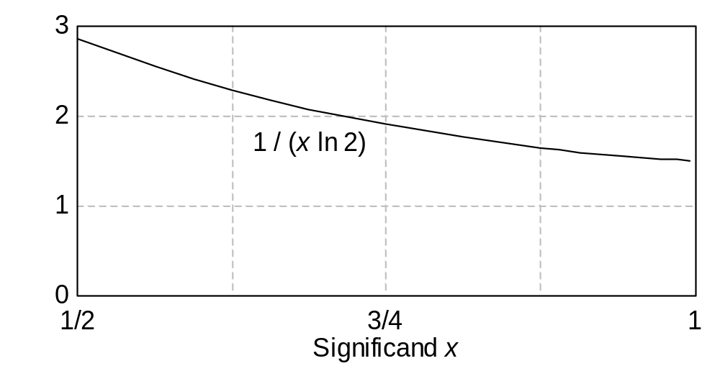
19.4 Error Distribution and Expected Errors
Probability density function for the distribution of radix-r floating-point significands is 1/(x ln r)
Fig. 19.1 Probability density function for the distribution of normalized significands in FLP(r = 2, p, A).

Slide 64
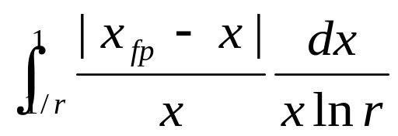
Maximum Relative Representation Error
MRRE = maximum relative representation error
MRRE(FLP(r, p, chop)) = r ^{–p+1}
MRRE(FLP(r, p, round)) = r ^{–p+1} / 2
From a practical standpoint, the distribution of errors and their expected values may be more important
Limiting ourselves to positive significands, we define:
ARRE(FLP(r, p, A)) =
1/(x ln r) is a probability density function

Slide 65
19.5 Forward Error Analysis
Consider the computation y = ax + b and its floating-point version
y_{fp} = (a_{fp} ×_{fp} x_{fp}) +_{fp} b_{fp} = (1 + η)y
Can we establish any useful bound on the magnitude of the relative error η, given the relative errors in the input operands a_{fp}, b_{fp}, x_{fp}?
The answer is “no”
Forward error analysis =
Finding out how far y_{fp} can be from ax + b,
or at least from a_{fp} x_{fp} + b_{fp}, in the worst case

Slide 66
Some Error Analysis Methods
Automatic error analysis
Run selected test cases with higher precision and observe differences between the new, more precise, results and the original ones
Significance arithmetic
Roughly speaking, same as unnormalized arithmetic, although there are fine distinctions. The result of the unnormalized decimal addition .1234 × 10⁵ +_{fp} .0000 × 10¹⁰ = .0000 × 10¹⁰ warns us about precision loss
Noisy-mode computation
Random digits, rather than 0s, are inserted during normalizing left shifts If several runs of the computation in noisy mode yield comparable results, then we are probably safe
Interval arithmetic
An interval [x_{lo}, x_{hi}] represents x, x_{lo} ≤ x ≤ x_{hi}. With x_{lo}, x_{hi}, y_{lo}, y_{hi} > 0,
to find z = x / y, we compute [z_{lo}, z_{hi}] = [x_{lo} /_{∇fp} y_{hi}, x_{hi} /_{Δfp} y_{lo}]
Drawback: Intervals tend to widen after many computation steps

Slide 67
19.6 Backward Error Analysis
Backward error analysis replaces the original question
How much does y_{fp} = a_{fp} ×_{fp} x_{fp} + b_{fp} deviate from y?
with another question:
What input changes produce the same deviation?
In other words, if the exact identity y_{fp} = a_{alt} x_{alt} + b_{alt}
holds for alternate parameter values a_{alt}, b_{alt}, and x_{alt},
we ask how far a_{alt}, b_{alt}, x_{alt} can be from a_{fp}, x_{fp}, x_{fp}
Thus, computation errors are converted or compared to additional input errors

Slide 68
Example of Backward Error Analysis
y_{fp} = a_{fp} ×_{fp} x_{fp} +_{fp} b_{fp}
= (1 + μ)[a_{fp} ×_{fp} x_{fp} + b_{fp}] with | μ | < r – p + 1 = r × ulp
= (1 + μ)[(1 + ν) a_{fp} x_{fp} + b_{fp}] with | ν | < r – p + 1 = r × ulp
= (1 + μ) a_{fp} (1 + ν) x_{fp} + (1 + μ) b_{fp}
= (1 + μ)(1 + σ)a (1 + ν)(1 + δ)x + (1 + μ)(1 + γ)b
≅ (1 + σ + μ)a (1 + δ + ν)x + (1 + γ + μ)b
So the approximate solution of the original problem is the exact solution of a problem close to the original one
The analysis assures us that the effect of arithmetic errors on the result y_{fp} is no more severe than that of r × ulp additional error in each of the inputs a, b, and x

Slide 69
20 Precise and Certifiable Arithmetic
Chapter Goals
Discuss methods for doing arithmetic
when results of high accuracy
or guaranteed correctness are required
Chapter Highlights
More precise computation through
multi- or variable-precision arithmetic
Result certification by means of
exact or error-bounded arithmetic
Precise / exact arithmetic with low overhead

Slide 70
Precise and Certifiable Arithmetic: Topics
Topics in This Chapter
20.1. High Precision and Certifiability
20.2. Exact Arithmetic
20.3. Multiprecision Arithmetic
20.4. Variable-Precision Arithmetic
20.5. Error-Bounding via Interval Arithmetic
20.6. Adaptive and Lazy Arithmetic

Slide 71
20.1 High Precision and Certifiability
There are two aspects of precision to discuss:
Results possessing adequate precision
Being able to provide assurance of the same
We consider 3 distinct approaches for coping with precision issues:
1. Obtaining completely trustworthy results via exact arithmetic
2. Making the arithmetic highly precise to raise our confidence
in the validity of the results: multi- or variable-precision arith
3. Doing ordinary or high-precision calculations, while tracking
potential error accumulation (can lead to fail-safe operation)
We take the hardware to be completely trustworthy
Hardware reliability issues to be dealt with in Chapter 27

Slide 72
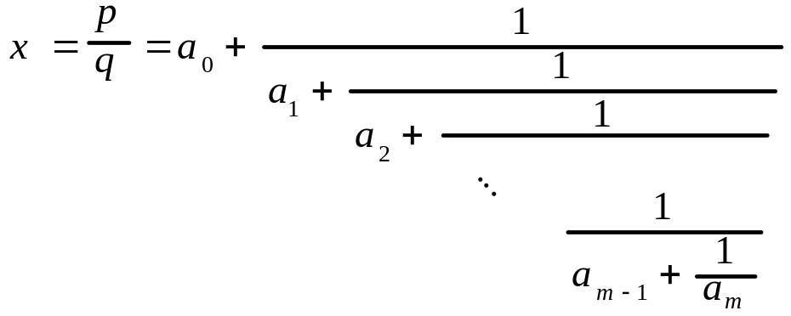
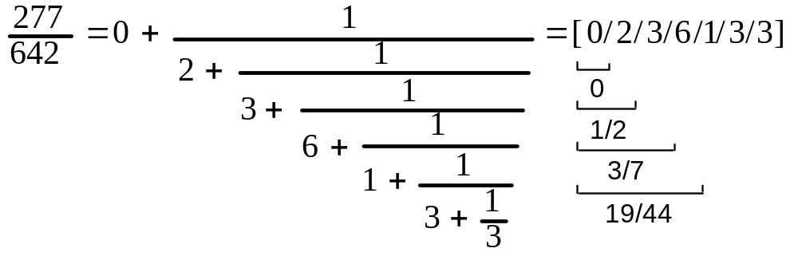
20.2 Exact Arithmetic
Continued fractions
Any unsigned rational number x = p/q has a unique continued-fraction expansion with a₀ ≥ 0, a_{m} ≥ 2, and a_{i} ≥ 1 for 1 ≤ i ≤ m – 1
Example: Continued fraction representation of 277/642
Can get approximations for finite representation by limiting the number of “digits” in the continued-fraction representation

Slide 73
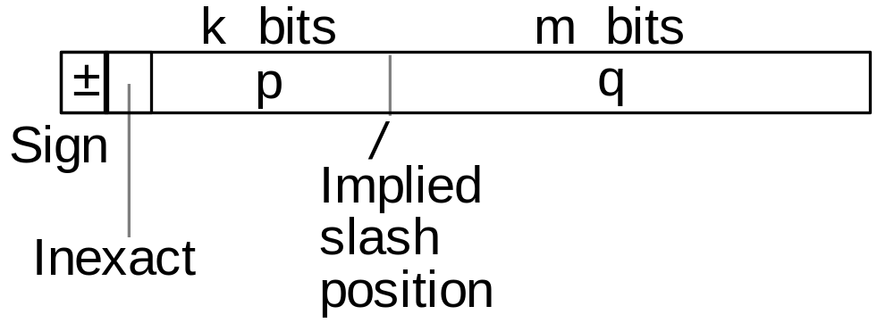
Fixed-Slash Number Systems
Represents p / q
Fig. 20.1 Example fixed-slash number representation format.
Rational number if p > 0 q > 0 “rounded” to nearest value
±0 if p = 0 q odd
±∞ if p odd q = 0
NaN (not a number) otherwise
Waste due to multiple representations such as 3/5 = 6/10 = 9/15 = . . . is no more than one bit, because:
lim_{n→∞} |{p/q | 1 ≤ p,q ≤ n, gcd(p, q) = 1}|/n² = 6/π² = 0.608

Slide 74
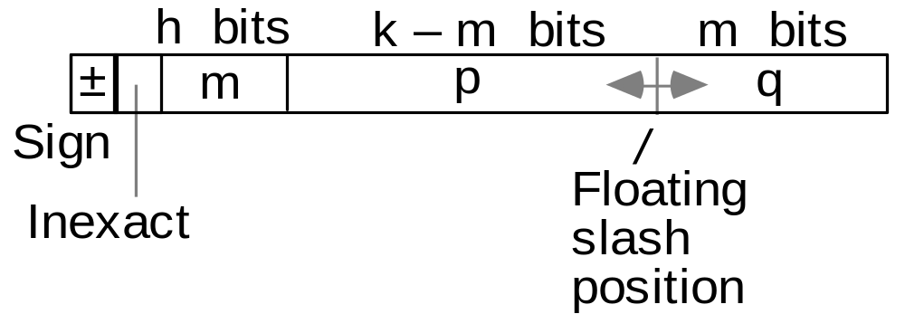
Floating-Slash Number Systems
Represents p / q
Fig. 20.2 Example floating-slash representation format.
Set of numbers represented:
{±p/q | p,q ≥ 1, gcd(p, q) = 1, ⎣log₂p⎦ + ⎣log₂q⎦ ≤ k – 2}
Again the following mathematical result, due to Dirichlet, shows that the space waste is no more than one bit:
lim_{n→∞} |{p/q | pq ≤ n, gcd(p,q) = 1}| / |{p/q | pq ≤ n, p,q ≥ 1}| = 6/π² = 0.608

Slide 75
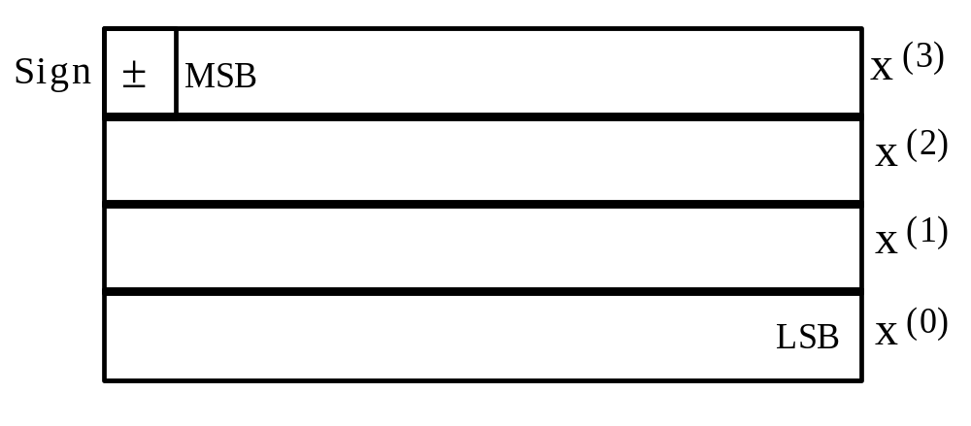
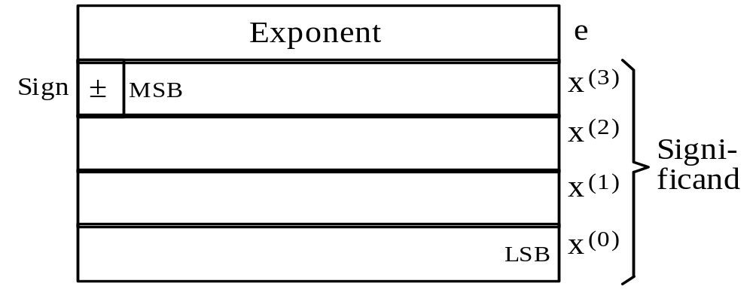
20.3 Multiprecision Arithmetic
Fig. 20.3 Example quadruple-precision integer format.
Fig. 20.4 Example quadruple-precision floating-point format.

Slide 76
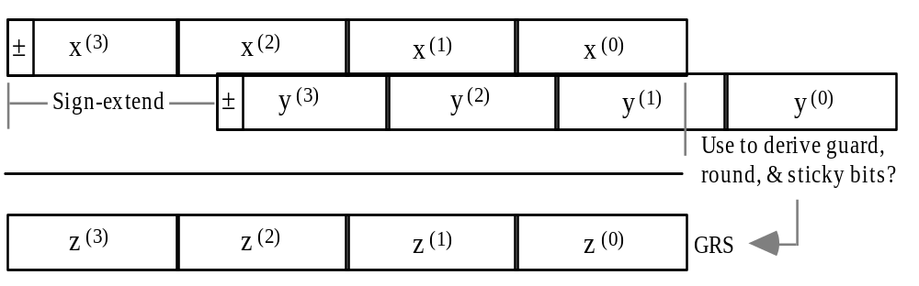
Multiprecision Floating-Point Addition
Fig. 20.5 Quadruple-precision significands aligned for the floating-point addition z = x +fp y.

Slide 77
Quad-Precision Arithmetic Using Two Doubles
x_{H} = 1.011100 . . . 101 × 2²⁰
x = x_{H} + x_{L}
x_{L} = 1.110101 . . . 110 × 2^{–33}
x = 1.011100 . . . 101 × 2²⁰
1110101 . . . 110
Key idea used: One can obtain an accurate sum for two floating-point numbers by computing their regular sum
s = x +_{fp} y and an error term e = y – (s – x)
The following website provides links to downloadable software packages for double-double and quad-double arithmetic
http://crd.lbl.gov/~dhbailey/mpdist/

Slide 78
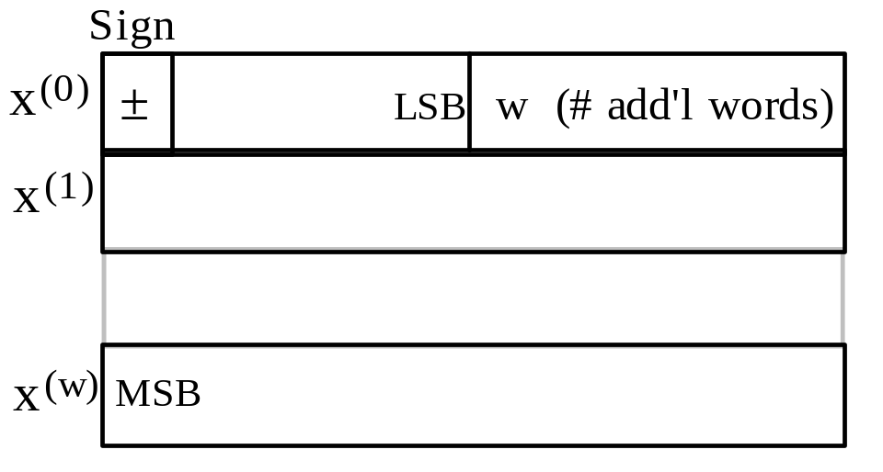
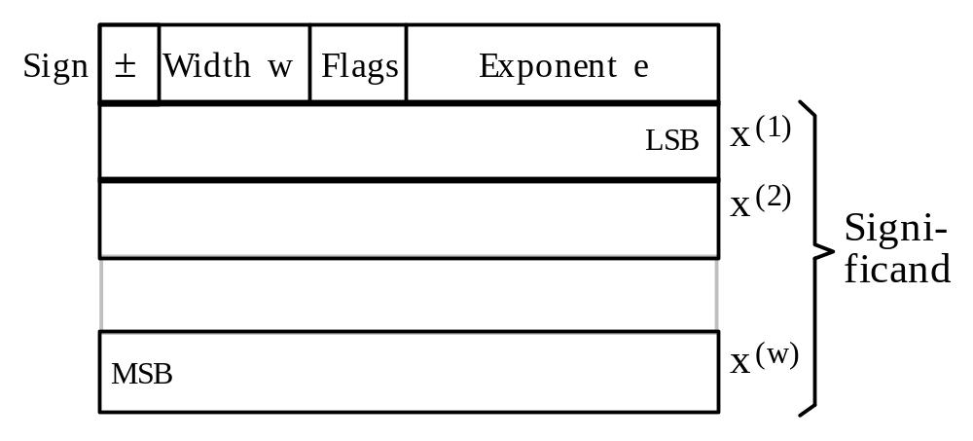
20.4 Variable-Precision Arithmetic
Fig. 20.6 Example variable-precision integer format.
Fig. 20.7 Example variable-precision floating-point format.

Slide 79
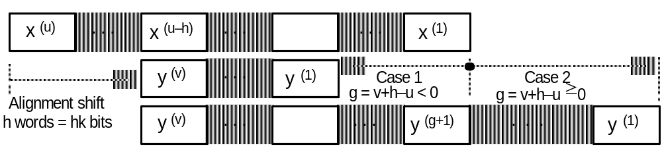
Variable-Precision Floating-Point Addition
Fig. 20.8 Variable-precision floating-point addition.

Slide 80
20.5 Error-Bounding via Interval Arithmetic
Interval definition
[a, b], a ≤ b, is an interval enclosing x, a ≤ x ≤ b
(intervals model uncertainty in real-valued parameters)
[a, a] represents the real number x = a
[a, b], a > b, is the empty interval
Combining and comparing intervals
[x_{lo}, x_{hi}] ∩ [y_{lo}, y_{hi}] = [max(x_{lo}, y_{lo}), min(x_{hi}, y_{hi})]
[x_{lo}, x_{hi}] ∪ [y_{lo}, y_{hi}] = [min(x_{lo}, y_{lo}), max(x_{hi}, y_{hi})]
[x_{lo}, x_{hi}] ⊇ [y_{lo}, y_{hi}] iff x_{lo} ≤ y_{lo} and x_{hi} ≥ y_{hi}
[x_{lo}, x_{hi}] = [y_{lo}, y_{hi}] iff x_{lo} = y_{lo} and x_{hi} = y_{hi}
[x_{lo}, x_{hi}] < [y_{lo}, y_{hi}] iff x_{hi} < y_{lo}

Slide 81
Arithmetic Operations on Intervals
Additive and multiplicative inverses
–[x_{lo}, x_{hi}] = [–x_{hi}, –x_{lo}]
1 / [x_{lo}, x_{hi}] = [1/x_{hi}, 1/x_{lo}], provided that 0 ∉ [x_{lo}, x_{hi}]
When 0 ∈ [x_{lo}, x_{hi}], the multiplicative inverse is [–∞,+∞]
The four basic arithmetic operations
[x_{lo}, x_{hi}] + [y_{lo}, y_{hi}] = [x_{lo} + y_{lo}, x_{hi} + y_{hi}]
[x_{lo}, x_{hi}] – [y_{lo}, y_{hi}] = [x_{lo} – y_{hi}, x_{hi} – y_{lo}]
[x_{lo}, x_{hi}] × [y_{lo}, y_{hi}] = [min(x_{lo}y_{lo}, x_{lo}y_{hi}, x_{hi}y_{lo}, x_{hi}y_{hi}),
max(x_{lo}y_{lo}, x_{lo}y_{hi}, x_{hi}y_{lo}, x_{hi}y_{hi})]
[x_{lo}, x_{hi}] / [y_{lo}, y_{hi}] = [x_{lo}, x_{hi}] × [1/y_{hi}, 1/y_{lo}]

Slide 82
Getting Narrower Result Intervals
Theorem 20.1: If f(x⁽¹⁾, x⁽²⁾, . . . , x^{(n)}) is a rational expression in the interval variables x⁽¹⁾, x⁽²⁾, . . . , x^{(n)}, that is, f is a finite combination of x⁽¹⁾, x⁽²⁾, . . . , x^{(n)} and a finite number of constant intervals by means
of interval arithmetic operations, then x^{(i)} ⊃ y^{(i)}, i = 1, 2, . . . , n, implies:
f(x⁽¹⁾, x⁽²⁾, . . . , x^{(n)}) ⊃ f(y⁽¹⁾, y⁽²⁾, . . . , y^{(n)})
Thus, arbitrarily narrow result intervals can be obtained by simply performing arithmetic with sufficiently high precision
With reasonable assumptions about machine arithmetic, we have:
Theorem 20.2: Consider the execution of an algorithm on real numbers using machine interval arithmetic in FLP(r, p, ∇|Δ). If the same algorithm is executed using the precision q, with q > p, the bounds for both the absolute error and relative error are reduced by the factor r^{q–p}
(the absolute or relative error itself may not be reduced by this factor; the guarantee applies only to the upper bound)

Slide 83
A Strategy for Accurate Interval Arithmetic
Theorem 20.2: Consider the execution of an algorithm on real numbers using machine interval arithmetic in FLP(r, p, ∇|Δ). If the same algorithm is executed using the precision q, with q > p, the bounds for both the absolute error and relative error are reduced by the factor r^{q–p}
(the absolute or relative error itself may not be reduced by this factor; the guarantee applies only to the upper bound)
Let w_{max} be the maximum width of a result interval when interval arithmetic is used with p radix-r digits of precision. If w_{max} ≤ ε, then we are done. Otherwise, interval calculations with the higher precision
q = p + ⎡log_{r} w_{max} – log_{r} ε⎤
is guaranteed to yield the desired accuracy.

Slide 84
20.6 Adaptive and Lazy Arithmetic
Need-based incremental precision adjustment to avoid
high-precision calculations dictated by worst-case errors
Lazy evaluation is a powerful paradigm that has been and is being used in many different contexts. For example, in evaluating composite conditionals such as
if cond1 and cond2 then action
evaluation of cond2 may be skipped if cond1 yields “false”
More generally, lazy evaluation means
postponing all computations or actions
until they become irrelevant or unavoidable
Opposite of lazy evaluation (speculative or aggressive execution) has been applied extensively

Slide 85
Lazy Arithmetic with Redundant Representations
Redundant number representations offer some advantages for lazy arithmetic
Because redundant representations support MSD-first arithmetic, it is possible to produce a small number of result digits by using correspondingly less computational effort, until more precision is actually needed

